Slide 1
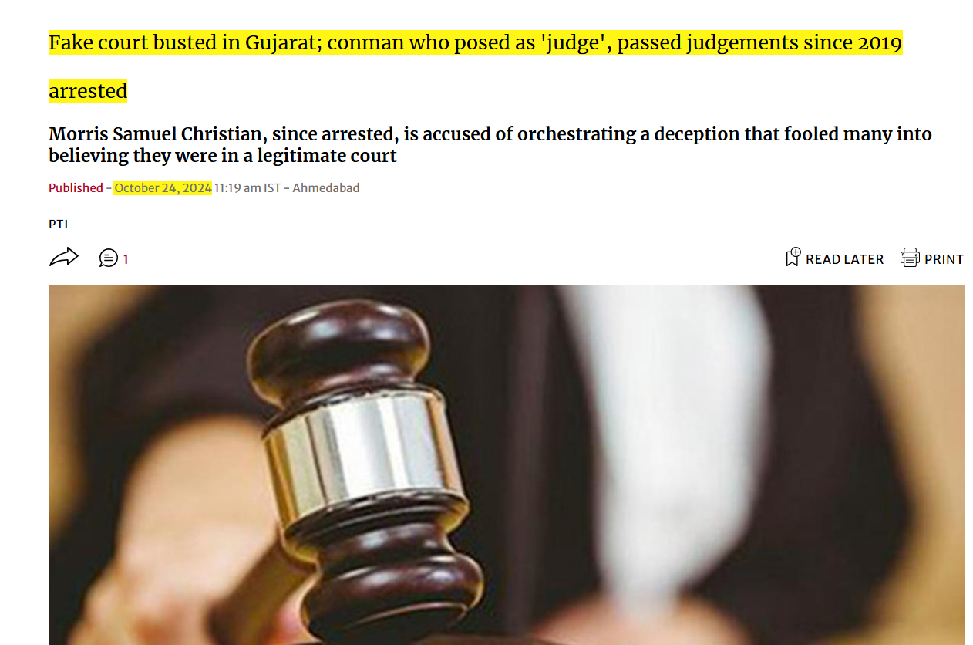

Slide 2
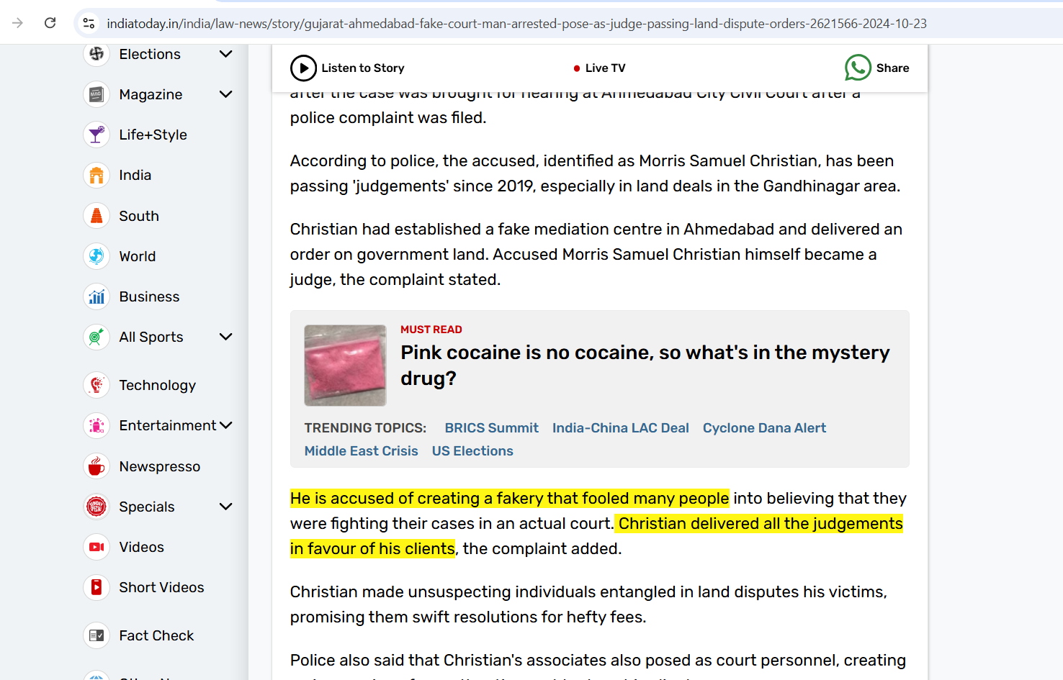

Slide 3
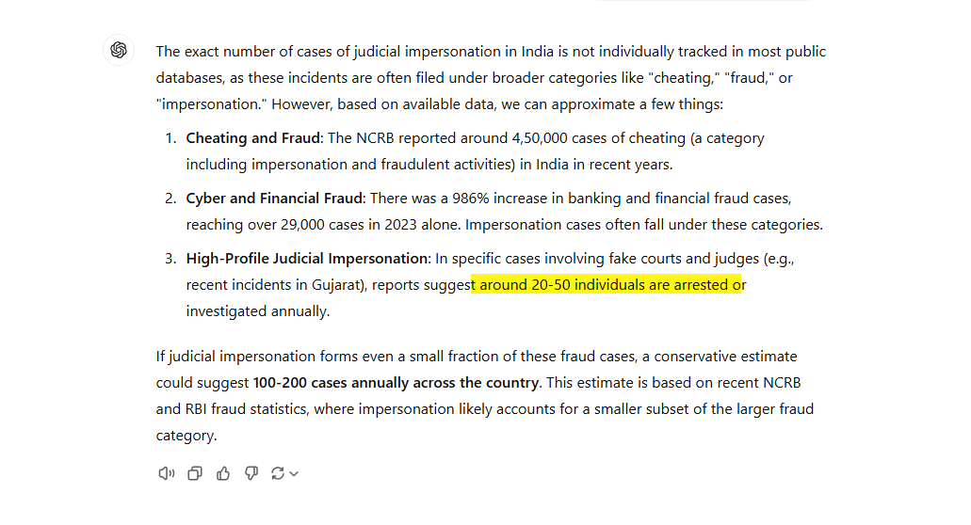

Slide 4

Nyaya Mitra
AI-Based Legal Decision
Support for Equitable Justice
Guide:
Prof. Shwetha G N
Assistant Professor,
Department of Computer Science and Engineering,
SJCE, Mysuru
Team 83 :
Manoj D Maiya ( 01JCE21CS061 )
Sujay T S ( 01JCE21CS107 )
Darsh Khetan ( 01JST21CS031 )

Slide 5

Introduction
Problem
Solution
The Indian judiciary grapples with millions of pending cases. Case analysis is complex and time-consuming, leading to significant delays in justice delivery.
An AI-powered system to predict judicial outcomes and provide legal insights. It aims to improve transparency and efficiency in the legal process.

Slide 6

Literature Review
1
Bhilare et al. (2019)
Explored machine learning models like SVM and Random Forest for case outcome prediction. Demonstrated potential for AI in legal decision-making.
2
Shaikh et al. (2020)
Focused on predicting murder case outcomes using legal factors and classifiers. Highlighted importance of domain-specific features in prediction.
3
Sengupta & Dave (2021)
Utilized multi-label classification for legal sections using NLP and ML. Showed promise in automating legal document analysis.

Slide 7
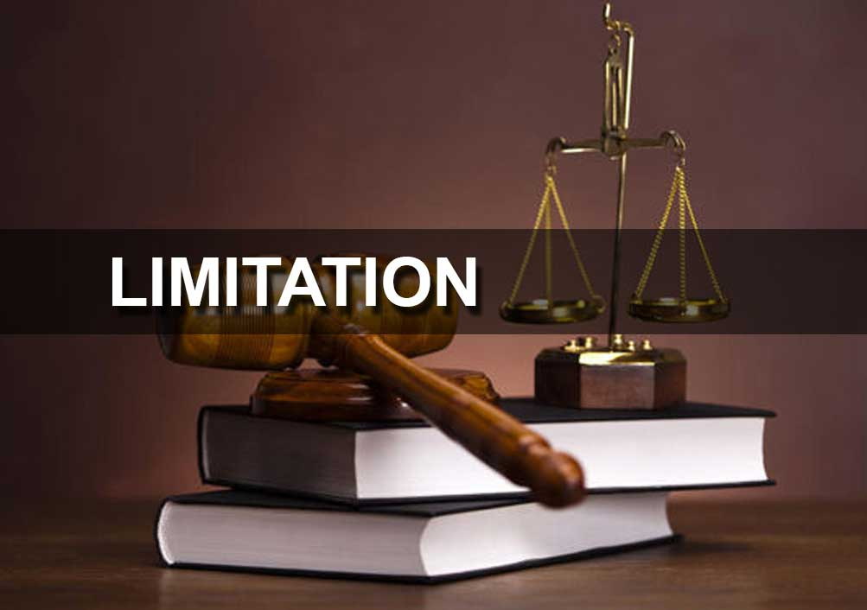
Limitations of Present Work
1
Data Availability
2
Legal Language Complexity
Limited public datasets hinder comprehensive analysis. Privacy concerns restrict access to sensitive legal information.
Standard NLP models struggle with interpreting legal jargon. Context-specific understanding is crucial for accurate predictions.
3
Bias in Judicial Data
4
Model Interpretability
Historical data may contain societal biases. AI models risk perpetuating unfair judgments if not carefully designed.
AI predictions must be explainable for legal transparency. Black-box models pose challenges in the justice system.

Slide 8





Objectives of the Work
Develop AI-Powered System
Ensure Fairness and Transparency
Automate Legal Document Summarization
Optimize Legal Case Analysis
Create a robust system to predict case outcomes and identify relevant legal sections. Enhance accuracy through advanced machine learning techniques.
Implement bias detection mechanisms and provide explainable predictions. Maintain ethical standards in AI-assisted legal decision-making.
Reduce time and improve decision-making efficiency. Provide data-driven insights to support legal professionals.
Develop NLP algorithms to extract key insights from lengthy legal texts. Reduce manual effort in document analysis.

Slide 9
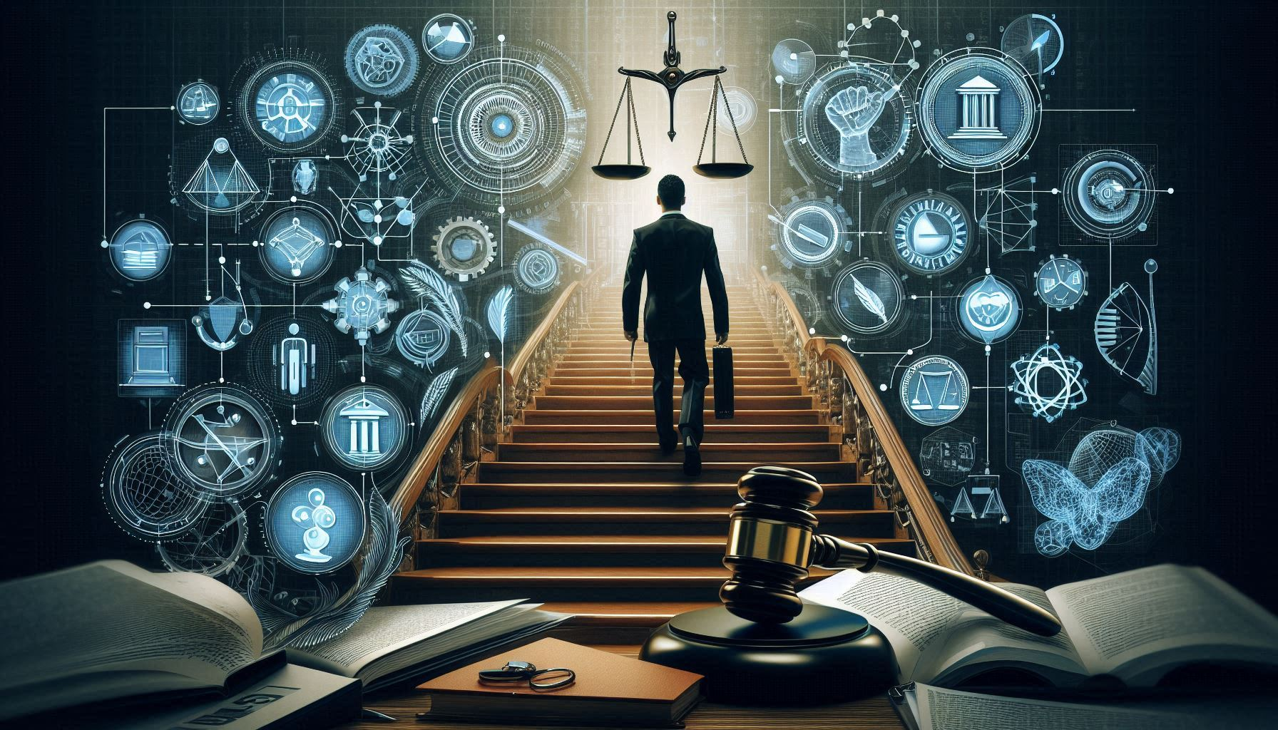
Methodology
Data Collection and Preprocessing
1
Judicial records, statutes, and case data are gathered and cleaned, with tokens generated for NLP processing. Sentiment analysis assesses tone for bias detection.
Data Transformation and Storage
2
Text data is converted to JSON, including case details and sentiment scores, and stored in a secure database like MongoDB.
Real-Time Notification System
3
Users receive real-time case updates via APIs, with triggers for changes in status or legal updates, sent through integrated email services.
Outcome Prediction Using Machine Learning
4
Classification models like Random Forest predict relevant legal sections and outcomes, enhanced by sentiment analysis to gauge tone in judicial language.

Slide 10
Methodology
Bias Detection and Regular Audits
5
Gather case data from Indian judicial repositories. Ensure diverse representation across legal domains and jurisdictions.
6
Enhanced Document and Identity Verification
AI models verify documents and identities through face recognition, enhancing security in case proceedings.
User Interface and Case Management
7
A centralized dashboard allows users to view case summaries, adjust notification settings, and access prediction and bias audit results.

Slide 11
Work Plan
Phase 1: Project Initialization
1
Gather requirements, design architecture, and identify
data sources for collection.
Phase 2: Data Collection and Processing
2
Collect, clean, and tokenize data, with a database set up
for JSON-structured documents.
Phase 3: Model Development
3
Train NLP models for legal understanding and implement prediction models with sentiment analysis integration.
Phase 4: Real-Time Notification System
4
Integrate APIs for real-time updates with user-controlled
notification triggers.

Slide 12
Work Plan
Phase 5: Bias Detection and Fairness Audits
5
Create a pipeline to detect bias across demographic groups, with scheduled audits for fairness.
6
Phase 6: Verification Systems
Develop document and face recognition models for secure identity
verification.
Phase 7: User Interface Development
7
Build a user-friendly dashboard for notifications, predictions,
and audit insights.
7
Phase 8: Testing and Deployment
8
Conduct module and integration testing, with user feedback for refinements
and deploy to cloud with continuous updates and regular model retraining for fairness.

Slide 13
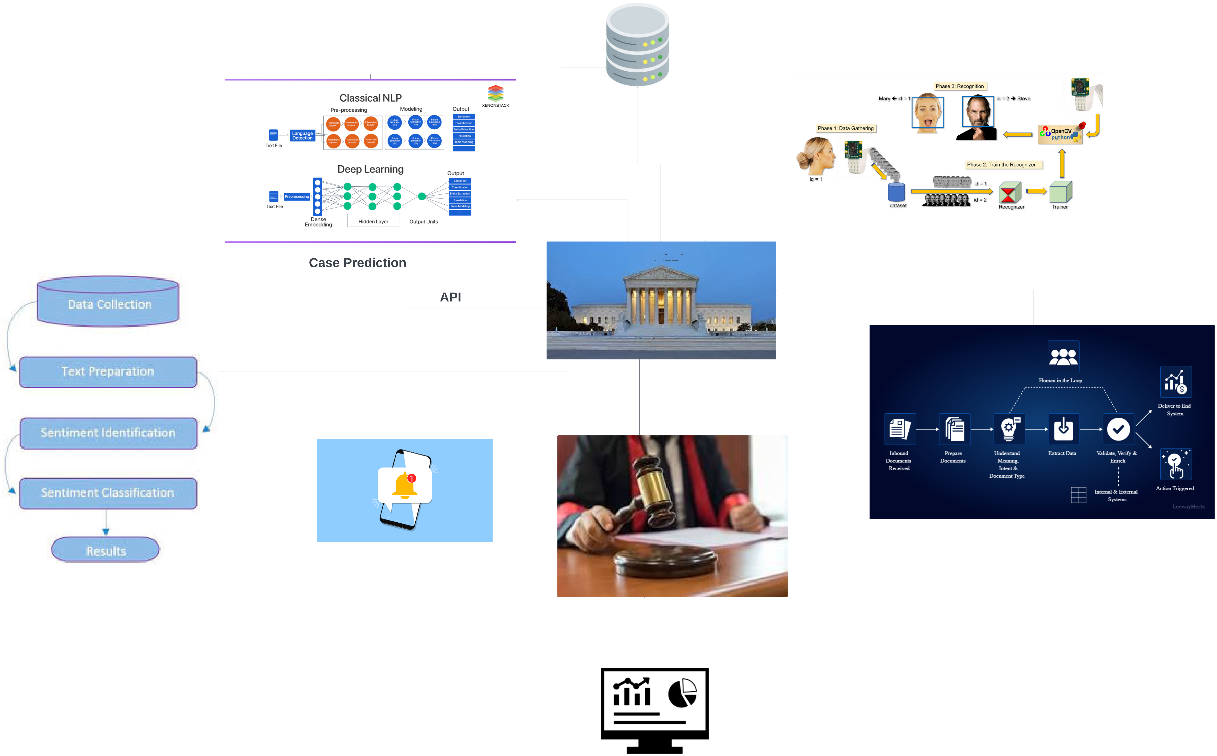

Slide 14
Tools and Technologies
1
Natural Language Processing
Models: BERT, GPT for legal text summarization and sentiment analysis
Libraries: NLTK, spaCy, Hugging Face Transformers
2
Machine Learning Models
Models: Random Forest, Logistic Regression, Support Vector Machines SVM for outcome prediction
Libraries: Scikit-Learn, XGBoost, TensorFlow for model training and deployment
3
Real-Time Notification System
APIs for real-time data . Provide users with real-time updates on case status changes, new rulings, and changes in legal statutes via email notifications.

Slide 15
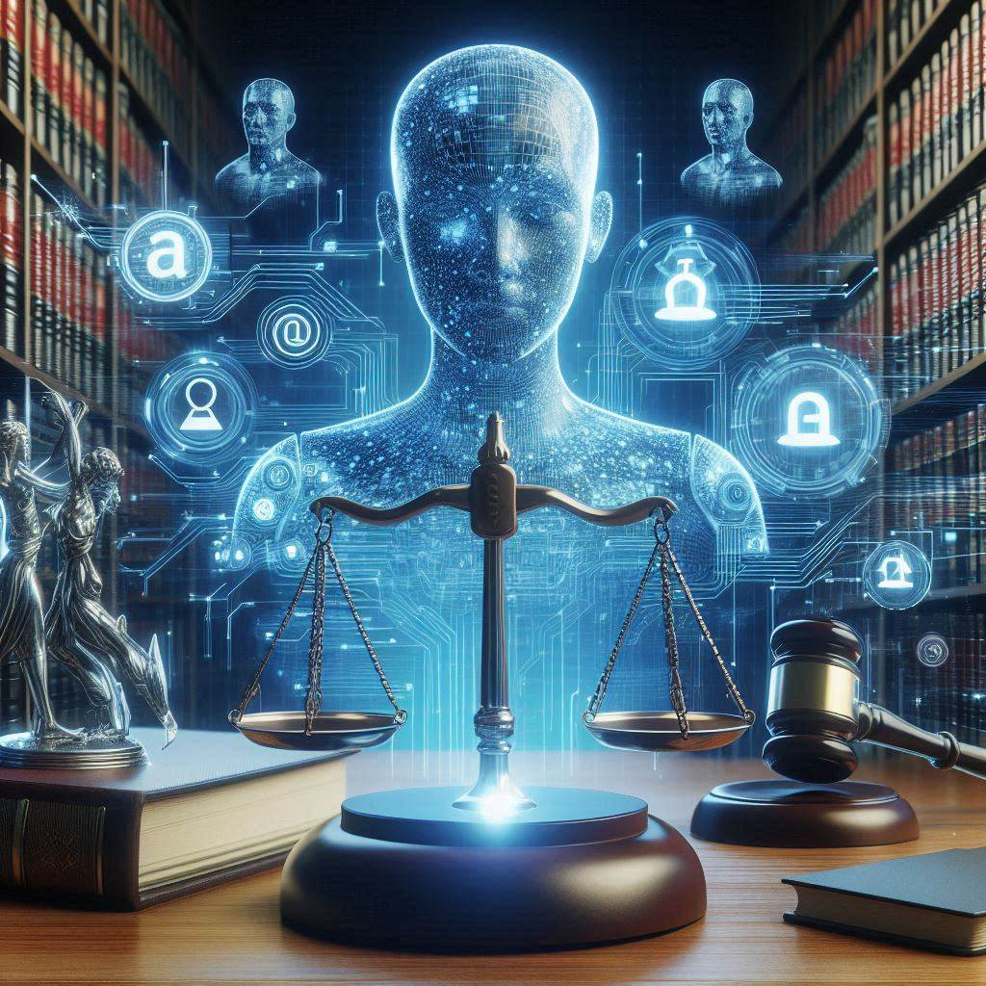
Conclusion and
Future Scope
Impact
Future Scope
The AI-powered system will reduce judicial delays and improve fairness. It will enhance efficiency for legal professionals by automating case analysis.
Scale the system to other legal domains. Incorporate advanced NLP techniques for improved accuracy and broader application.
Ethical Considerations
Address privacy concerns and ensure responsible AI use. Develop guidelines for AI integration in the justice system.

Slide 16
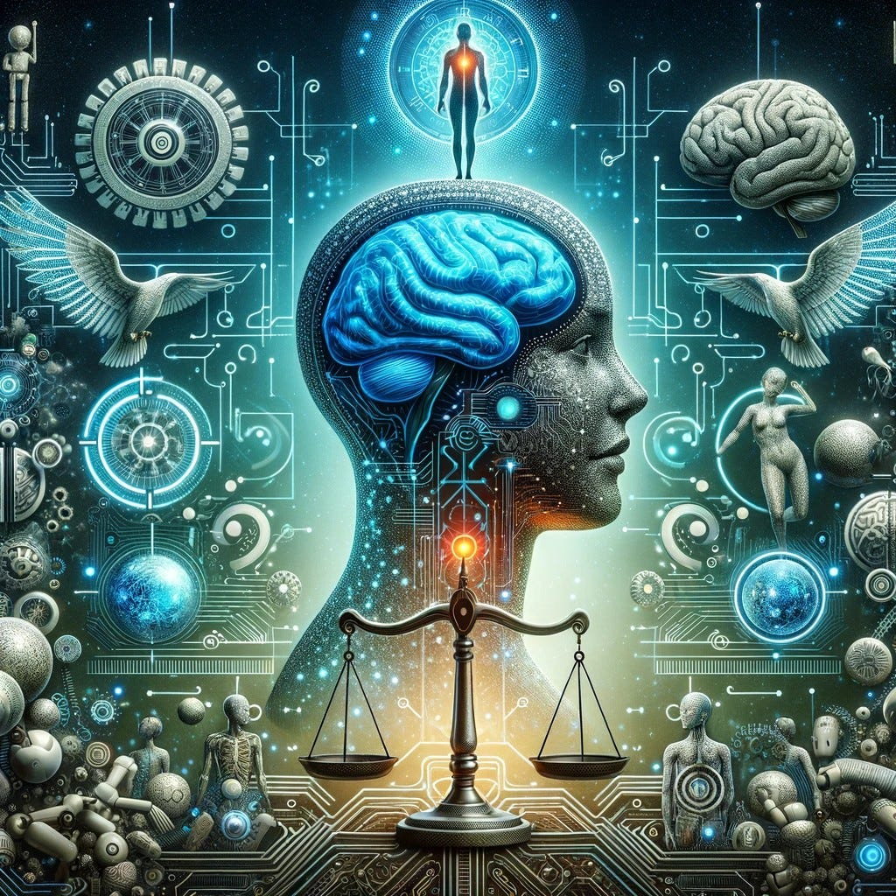
THANK YOU

